Slide 1
The Battle of Neighbourhoods
By,
Jon Doyle

Slide 2
INTRODUCTION
New York City, simply called New York and abbreviated as NYC, is the most populous city in the United States. With an estimated 2019 population of 8,336,817 distributed over about 302.6 square miles, New York City is also the most densely populated major city in the United States.
Situated on one of the world's largest natural harbors, New York City is composed of five boroughs, each of which is a county of the State of New York. The five boroughs—Brooklyn, Queens, Manhattan, the Bronx, and Staten Island—were consolidated into a single city in 1898. The city and its metropolitan area constitute the premier gateway for legal immigration to the United States. As many as 800 languages are spoken in New York, making it the most linguistically diverse city in the world. New York is home to more than 3.2 million residents born outside the United States, the largest foreign-born population of any city in the world as of 2016.
The Restaurants industry in New York has experienced steady growth over the five years to 2018, as convenient and affordable food remains popular with consumers. While the low price point of the industry's products typically places restaurants and coffee shops with a competitive advantage over other segments of the foodservices sector, rising consumer sentiment has increased competition overall. Furthermore, with the rise of fast-casual concepts rapidly gaining market share, major industry operators have had to alter their offerings to effectively compete.
Given the history mentioned this project will attempt to answer a number of questions related to Chinese Restaurants.
Notes:
Insert a map of your country.

Slide 3
Problem:
Find the answers to the following questions:
What is the best location in New York City for Chinese Food?
Which areas have potential for additional Chinese Restaurants?
Which is the best place to stay if you prefer Chinese Food?
List and visualize all major parts of New York City that has high ranked Chinese restaurants
Notes:
Insert a picture of one of the geographic features of your country.

Slide 4
Data Section:
For this project we need the following data:
New York City data that contains list Boroughs, Neighbourhoods along with their latitude and longitude.
Data source : https://cocl.us/new_york_dataset
Description: This data set contains the required information. And we will use this data set to explore various neighbourhoods of New York City.
Chinese restaurants in each neighbourhood of New York City.
Data source : Foursquare API
Description: By using this API we will get all the venues in each neighbourhood. We can filter these venues to get only Indian restaurants.
GeoSpace data
Data source : https://data.cityofnewyork.us/City-Government/Borough-Boundaries/tqmj-j8zm
Description: By using this geo space data we will get the New York Borough boundaries that will help us visualize choropleth map.
Notes:
Insert a picture illustrating a season in your country.

Slide 5
Methodology:
We begin by collecting the New York city data from "https://cocl.us/new_york_dataset".
We will find all venues for each neighborhood using FourSquare API Developer Account.
We will then filter out all Chinese Restaurant venues.
Next using FourSquare API, we will find the Ratings, Tips, and Like count for all the Chineses Restaurants.
Next, we will sort the data keeping Ratings as the constraint.
Finally, we will visualize the Ranking of neighborhoods using python's Folium library.
Notes:
Insert a picture of an animal and or plant found in your country.

Slide 6
Conclusion:
Now we can answer the questions asked above in the Questions section:
What is best location in New York City for Chinese Food?
In the borough of Manhattan, the following locations are tops based on:
Ratings: Kings County Imperial in the Lower East Side
Tips: Buddakan in Chelsea
Likes: Buddakan in Chelsea
Which areas have potential for additional Chinese Restaurants?
Staten Island has the fewest Chinese Restaurants however, the Bronx has the lowest rated Chinese Restaurants so depending on the type of Chinese Restaurant could further research these to areas to which one is a better fit.
Which is the best place to stay if you prefer Chinese Food?
Manhattan is the best place to stay to find the best rated Chinese Food.
Notes:
Add key points in the history of your country to the timeline.

Slide 7
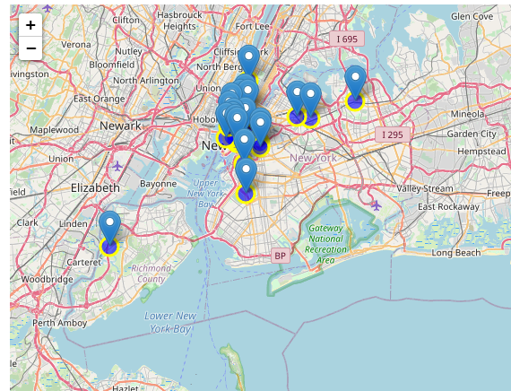
Conclusion (continued):
Visualize Top Rated Neighborhoods on a map
Notes:
Add key points in the history of your country to the timeline.

